Slide 1
Predicting Hospital Readmission of Diabetes Patients
By: Minh Quan Do

Slide 2
Background
4.6% growth in 2016 compared to a 4.1% growth in 2015 which is also an increase from just over 3% growth from 2012-2014 [1]
30.3 million people in the United States (9.4% of the U.S. population) has diabetes [2]
7.2 million patients discharged from hospitals were diagnosed with diabetes [2]
diabetes is the seventh leading cause of death in the United States in 2015 [2]

Slide 3

Data
Dataset: Diabetes 130-US hospitals for years 1999-2008 Data Set
Retrieved from UCI Machine Learning Repository

Slide 4
Original Dataset had…
55 features
3 Class Labels:
‘NO’ = patient has not been readmitted into hospital
‘<30’ = Readmitted into hospital within 30 days after leaving
‘>30’ = Readmitted into hospital more than 30 days after leaving
101,766 data points

Slide 5

Data Preprocessing
Reduced 55 attributes down to 6
Reduced number of instances down to 99,493
Split dataset into…
Training set (34,000 data points)
Validation set (34,000 data points)
Test set (31,491 data points)

Slide 6
features
Age (ordinal)
Race (nominal)
Gender (nominal)
Number of emergency visits in the year preceding encounter (numeric)
Number of inpatient visits in the year preceding encounter (numeric)
Diabetic medication prescribed

Slide 7
Class Labels
‘<30’ = readmitted within 30 days after being discharged
‘>30’ = Readmitted after 30 days of being discharged
‘NO’ = Not readmitted

Slide 8
Approach 1: k-means clustering & ANN: Clustering & ANN
Training:
Use K-means clustering to form groups of patients with similar characteristics
Use data points in one group to train ANN
Predicting class labels
Classify data point into a particular group
Use ANN to predict class label of that data point

Slide 9
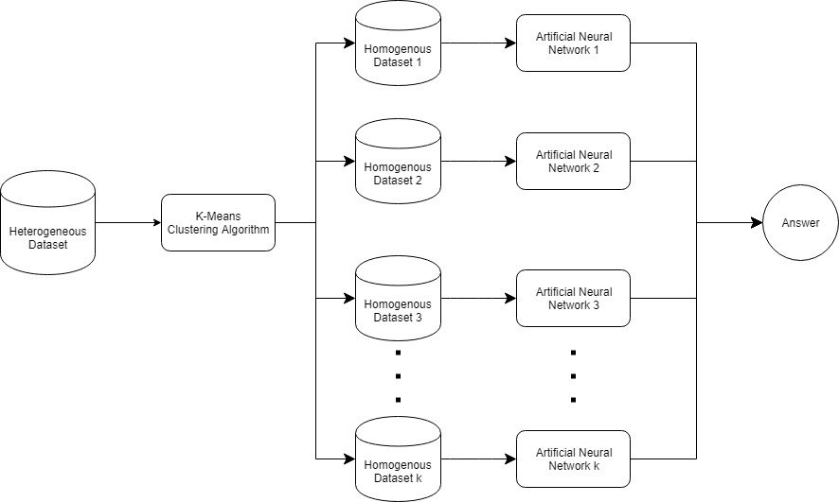
Model Diagram

Slide 10
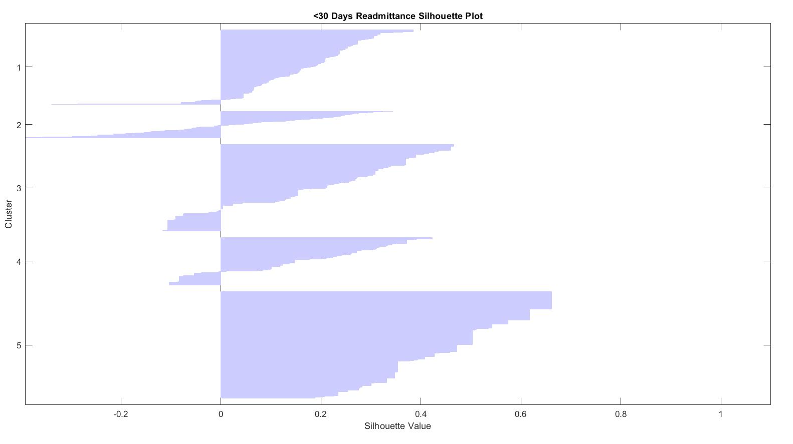
Clustering did not work…
Too many point were being misclassified
Data is too convoluted and clusters were not separable

Slide 11
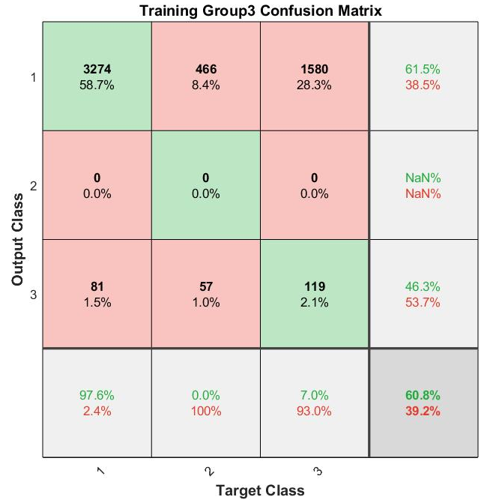
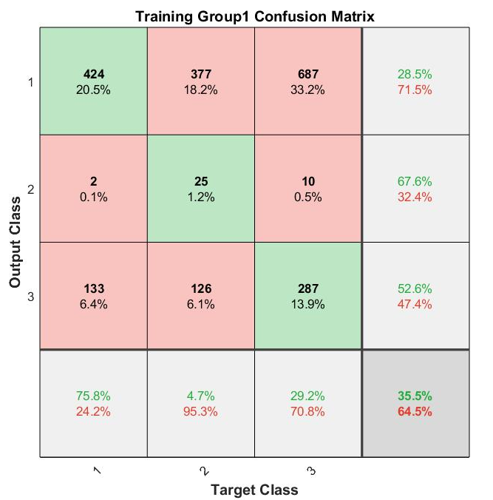
Training accuracy

Slide 12
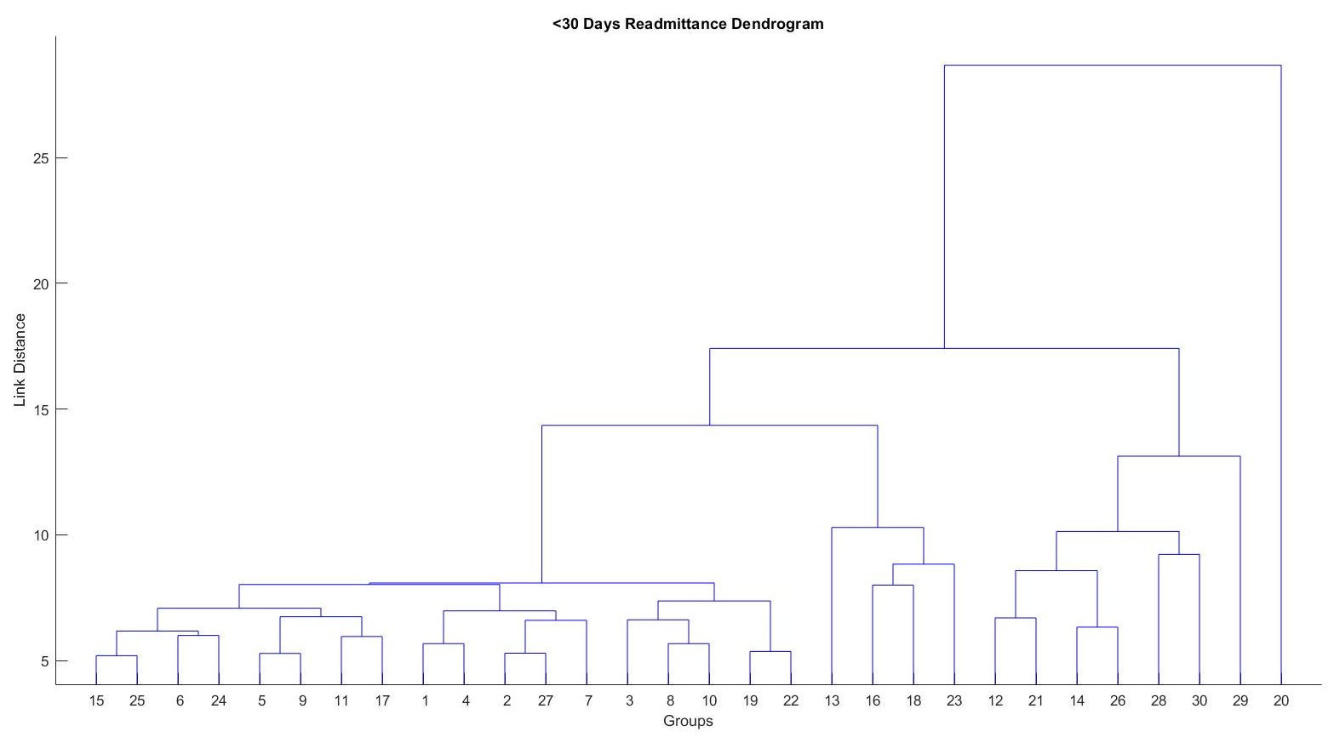
Approach 2: Hierarchical Clustering
Ran into the exact same problem as k-Means
Data was extremely difficult to separate and therefore hard to cluster

Slide 13
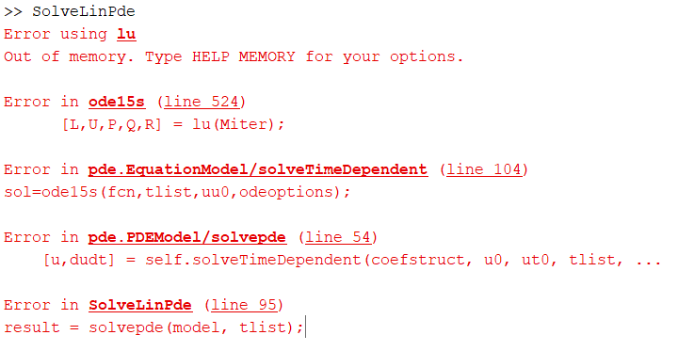
Approach 3: KNN
Use classic KNN algorithm with standard Euclidean distance
Train knn on training set
Use knn to predict data points in validation set and test set
Unfortunately knn did not work either, too computationally expensive and accuracy was very low

Slide 14

Approach 4: change class labels
Change all values with class label “>30” (readmitted after 30 days) to “NO” (not readmitted)
Damian mingle did the same method in his paper: Predicting Diabetic Readmission Rates: Moving Beyond HbA1c [3]
Totally not cheating
Damian Mingle Chief Data Scientist & Cofounder at SwitchPoint Ventures

Slide 15
About model
Use knn algorithm to classify data points in validation/test set
Set K = 1
Why k = 1?
If k > 15, Training accuracy could be as high has 89.1%
However, sensitivity would decrease to 2.02%

Slide 16

Approach 4 results
accuracy = 80.5%
Sensitivity = 17.11%
Specificity = 88.23%

Slide 17
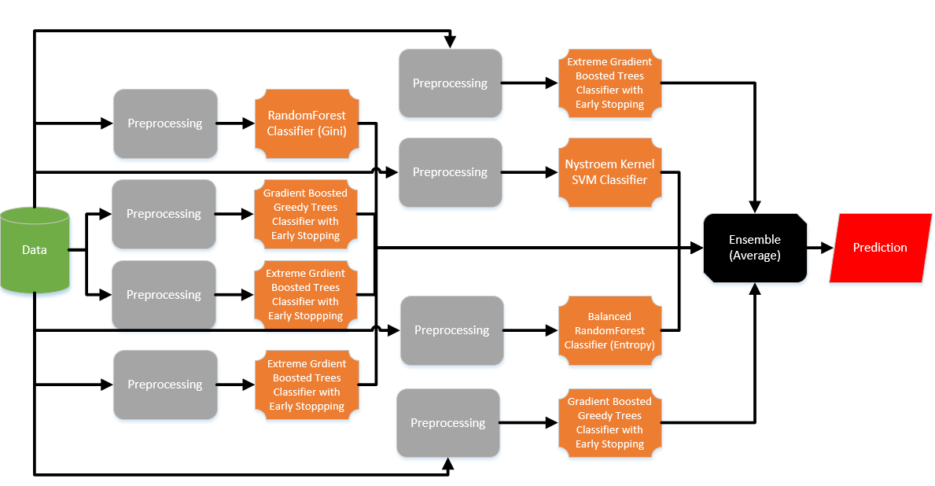
Comparison to other literature
Mingle used much more complex models [3]
His model yielded:
Accuracy = 84.81%
Sensitivity = 49.78%
Specificity = 89.19%

Slide 18
conclusion
Changing class labels allowed for a much better testing accuracy
A possible reason for this might be due to:
Over-representation of data points labeled ‘NO’ (not readmitted)
Points with class label ‘>30’ was interfering with the prediction of points labeled “not readmitted”
Converting ‘>30’ to “Not readmitted” helped increase the training accuracy because more points can now be correctly classified as “not readmitted” rather than ‘>30’

Slide 19
Works cited
United States, Congress, “2016 Health Care Costs and Utilization Report.” 2016 Health Care Costs and Utilization Report, 2016.
United States, Congress, Division of Diabetes Translation. “National Diabetes Statistics Report.” National Diabetes Statistics Report, 2017.
Mingle, Damian. “Predicting Diabetic Readmission Rates: Moving Beyond HbA1c”. Current Trends in Biomedical Engineering & Biosciences, 2017, 7. 10.19080/CTBEB.2017.07.555715.

